Slide 1
Transferring Data into Stata From Microsoft Excel or Access
Nathan Favero
June 7, 2013

Slide 2
Transferring Data from Excel to Stata
Microsoft Excel 2010

Slide 3
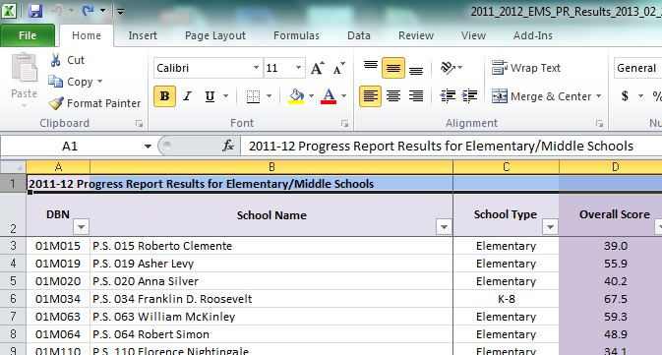
Transferring Data from Excel to Stata
Delete Extra Rows

Slide 4
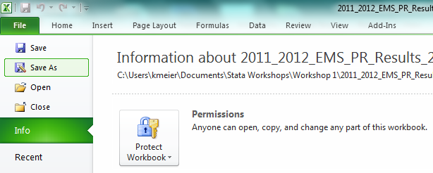
Transferring Data from Excel to Stata
Save As

Slide 5
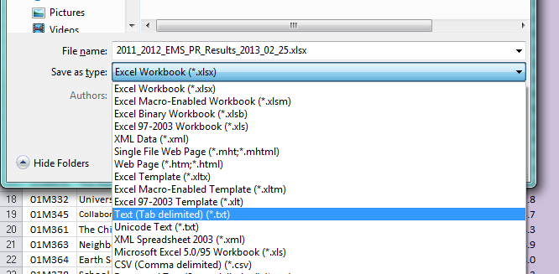
Transferring Data from Excel to Stata
Select “Text” or “CSV”

Slide 6
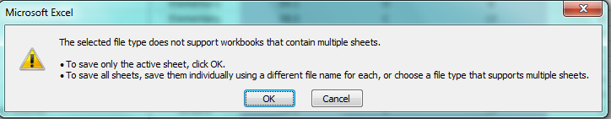
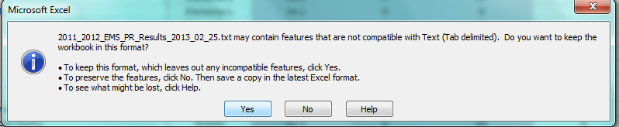
Transferring Data from Excel to Stata
Select “OK” and then “Yes”

Slide 7
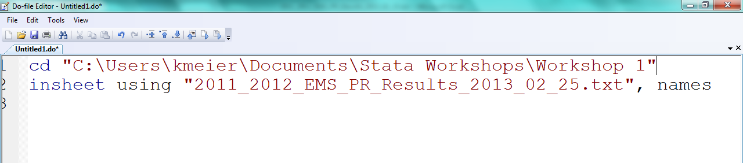
Transferring Data from Excel to Stata
Change Directory (This tells Stata what folder to look in.)
Filename
This tells Stata that the first row of the document contains variable names.
Use this command to read in comma- or tab-delimited files.

Slide 8
Transferring Data from Access to Stata
Microsoft Access 2010

Slide 9
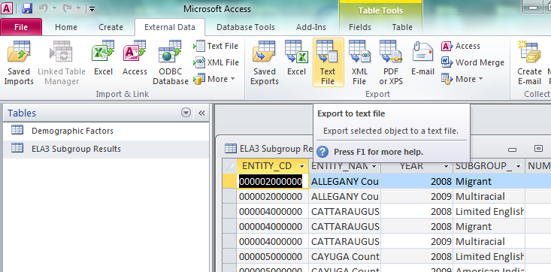
Transferring Data from Access to Stata
External Data → Text File (Export)

Slide 10
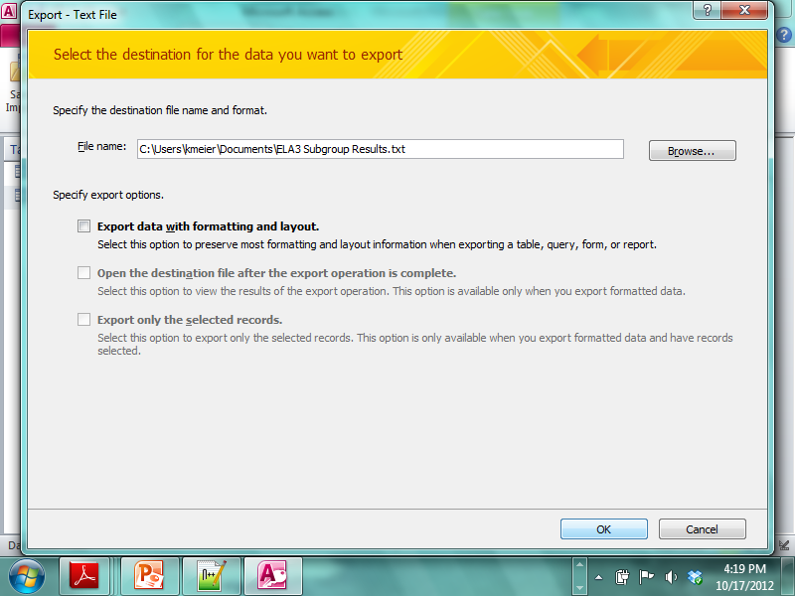
Transferring Data from Access to Stata
Select a file location and name. Click OK.

Slide 11
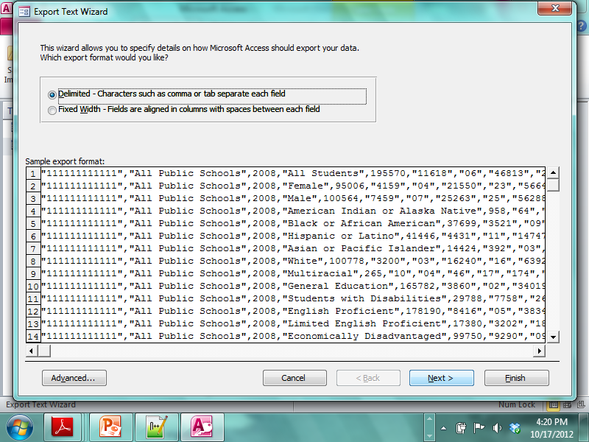
Transferring Data from Access to Stata
Click Next.

Slide 12
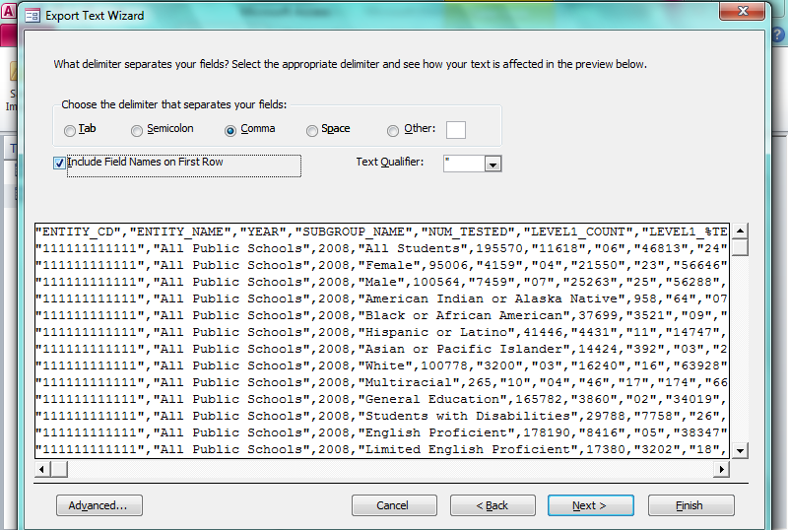
Transferring Data from Access to Stata
Select “Include Field Names on First Row.”
Click Finish.

Slide 13
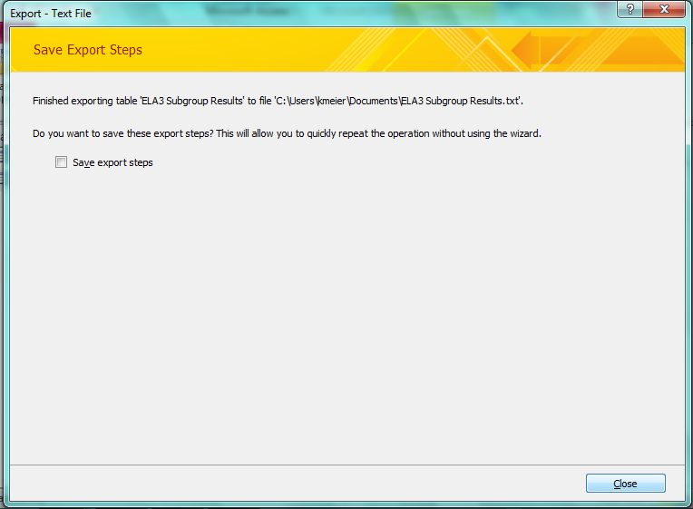
Transferring Data from Access to Stata
Click Close.

Slide 14
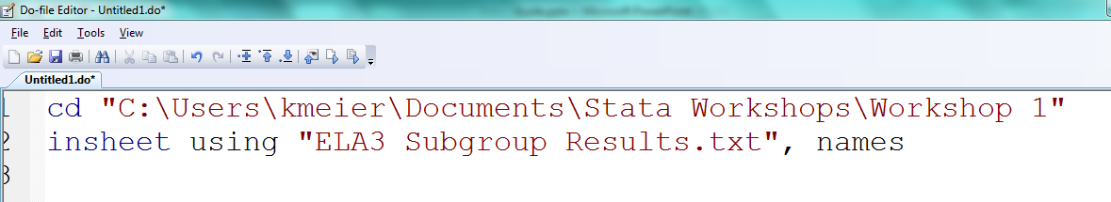
Transferring Data from Access to Stata
Change Directory (This tells Stata what folder to look in.)
Filename
This tells Stata that the first row of the document contains variable names.
Use this command to read in comma- or tab-delimited files.

